Slide 1
Sign Language Detection
Enhancing Communication for the Deaf and Hard of Hearing
Created by-
VARUN KUMAR(2022432344)
NITIN THAKUR(2022008213)

Slide 2
Problem Statement
Deaf individuals face significant communication barriers in their daily lives, particularly when interacting with those who do not understand sign language. This lack of understanding often leads to social isolation and difficulty accessing services, education, and employment opportunities. Traditional communication methods, such as written notes or interpreters, can be cumbersome and are not always readily available. As a result, there is a pressing need for an innovative solution that can facilitate real-time communication between deaf individuals and the broader population. Our project seeks to address this challenge by developing a system that can automatically recognize and translate sign language gestures into text or speech, thereby breaking down communication barriers and enabling more inclusive and effective interactions.

Slide 3
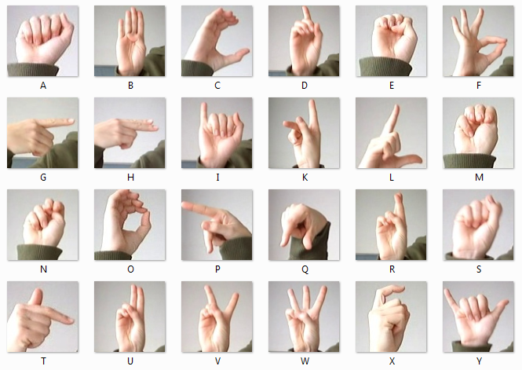
Sign Languages Gestures

Slide 4
Project Objectives
The main goal of this project is to build a system that can quickly and accurately recognize sign language gestures in real-time. It uses OpenCV and machine learning to turn video input into text or speech. The project also wants to create an easy-to-use interface that helps deaf people and those who don’t know sign language communicate better.

Slide 5
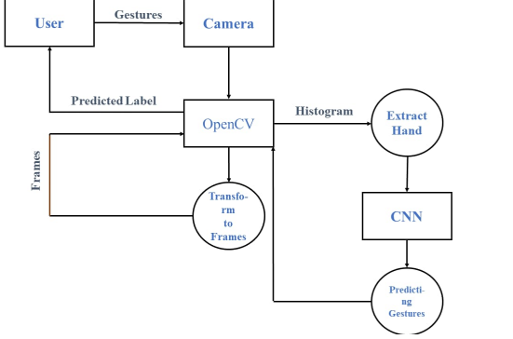
Data Flow Diagram

Slide 6
Methodology
The project’s methodology begins with data collection, where a custom dataset of sign language gestures is created using a camera. OpenCV is used to find hands in the video and pick out important details like the shape and position of the hand. These features are fed into a Convolutional Neural Network (CNN) model, trained specifically to classify different gestures. Once recognized, the gestures are translated into either text or speech, providing real-time feedback to the user.

Slide 7
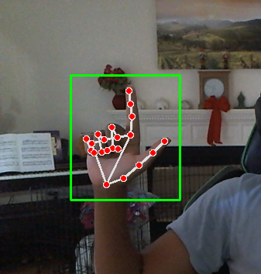
Implementation
Using a standard webcam or smartphone camera, our system captures real-time video of the user's hand gestures, which are made using various finger positions and movements to represent different sign language symbols. OpenCV processes these video frames to detect the user's hand, identify key contours or landmarks, and analyze the finger positions. By leveraging machine learning models like Convolutional Neural Networks (CNNs), the system recognizes the gestures and translates them into corresponding text or speech, providing real-time feedback as the user makes each gesture.

Slide 8
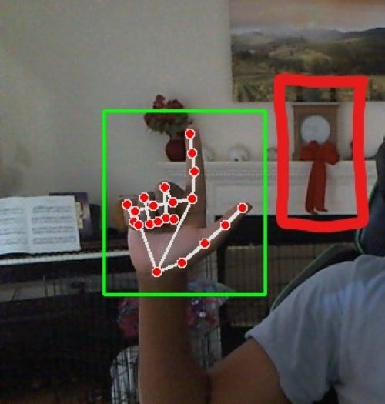
Challenges and Future Work
One of the main challenges encountered in this project was dealing with variations in lighting and background, which can significantly impact hand detection accuracy. Additionally, more complex gestures, particularly those involving both hands or rapid movements, posed greater difficulties in recognition. Moving forward, the project will focus on expanding the range of sign languages recognized by the system and improving accuracy under varying environmental conditions, ensuring the system's robustness in diverse real-world settings.

Slide 9
Conclusion
This project has shown that using OpenCV and machine learning works well for recognizing and translating sign language in real-time. The system can correctly understand hand signs and turn them into words, helping to close the communication gap between deaf people and those who can hear.
Because it works in real-time and is easy to use, it’s useful for daily life. Since communication is a basic human right, this technology can help millions of deaf and hard-of-hearing people feel more independent and confident when talking to others.
In the future, the project will try to include more sign languages and make the system more accurate and better in different situations. With more improvements, this system could be added to things like phones, computers, and public displays, becoming a helpful tool at home, school, or work.
In the end, this project shows how technology can help build a more inclusive world where everyone can share ideas and be part of society.

Slide 10
Thank You

